Slide 1
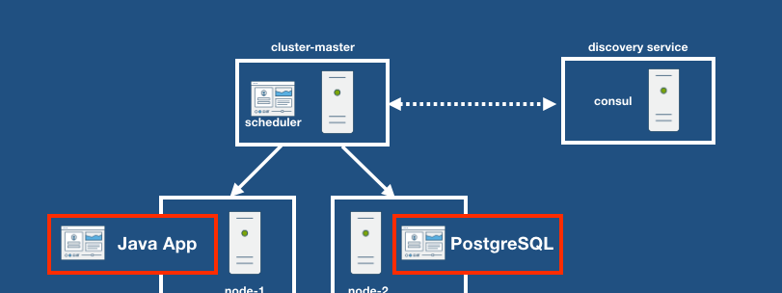
Software Development & Best Practices
This Photo by Unknown Author is licensed under CC BY-SA
Lecture 6 – Web Architecture II

Slide 2
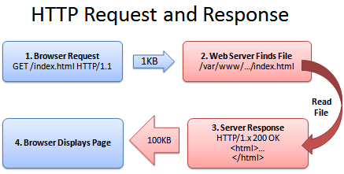
The story so far…
HTTP works via a series of requests and responses.
HTTP requests primarily employ one of two request methods:
GET –Here the user can only specify a path. This can be used to send data to the server by use of a ‘? Followed by a list of name/value pairs separated by an equals sign. Multiple fields can be separated by an ‘&’ character.
E.g.: GET /index.html?user=larry&pass=xiao POST – where the user can specify a path and provide data in the body of the HTTP request.
This Photo by Unknown Author is licensed under CC BY-SA

Slide 3
The story so far…
HTTP responses contain a header and a body.
The header contains the response code telling you if the request was successful. It also contains the content-type which tells the browser what kind of data is being returned. So, the browser can decide what to do with it! HTTP/1.1 200 OK Content-Type: text/html
The body is simply the data that the request is providing to you. i.e. HTML, PDF file, etc..
This Photo by Unknown Author is licensed under CC BY-SA

Slide 4
Cookies
Based on our current model we can send data to the webserver, but the server doesn’t keep any information about us from page to page.
Think about a web application where you had to log in with a username and password. You could write a web application that would present a login page unless the user had submitted a form with the correct credentials.
<?php
if ( $user_sent_password == False ) { printf("%s",$login_page);
} else { printf("%s",$secret_page); } ?>

Slide 5
Cookies
What would happen if the user went to another page on this site and then returned here?
The user would have to submit their password again!
This is known as the problem of persistence.
To solve this application developers would often put a form on every page and in it would be a hidden field.
<?php if ( $user_sent_password == False ) { printf("%s",$login_page);
} else { printf("%s",$secret_page); printf("<form><input type='hidden' name='username' value='dave’/></form>"); } ?>

Slide 6
Cookies
This approach was clumsy. It required every page on the website to submit a form to the webserver.
So, in 1995 Netscape came up with the idea of allowing the web server to send the browser data which would automatically be sent back to the server with every request.
This was known as a HTTP cookie.
HTTP/1.1 200 OK Date: Sun, 24 Jan 2021 19:58:38 GMT Server: Apache Set-Cookie: username=xiao Vary: Accept-Encoding Content-Encoding: gzip Content-Length: 107 Keep-Alive: timeout=5, max=100 Connection: Keep-Alive Content-Type: text/html; charset=UTF-8

Slide 7
Cookies
The approach was simple.
Create a new header set-cookie. Containing name/value pairs just like GET and POST.
We then modify the browser so that when it sees this header it stores this data.
HTTP/1.1 200 OK Date: Sun, 24 Jan 2021 19:58:38 GMT Server: Apache Set-Cookie: username=xiao Vary: Accept-Encoding Content-Encoding: gzip Content-Length: 107 Keep-Alive: timeout=5, max=100 Connection: Keep-Alive Content-Type: text/html; charset=UTF-8

Slide 8
Cookies
The next time that browser creates a request for the same website it sends those name/value pairs in a header called cookie.
GET /monster.php HTTP/1.1 Host: 172.16.1.242 User-Agent: Mozilla/5.0 (Windows NT 10.0; Win64; x64; rv:84.0) Gecko/20100101 Firefox/84.0 Accept: text/html,application/xhtml+xml,application/xml;q=0.9,image/webp,*/*;q=0.8 Accept-Language: en-CA,en-US;q=0.7,en;q=0.3 Accept-Encoding: gzip, deflate DNT: 1 Connection: keep-alive Cookie: username=xiao Upgrade-Insecure-Requests: 1 Sec-GPC: 1

Slide 9
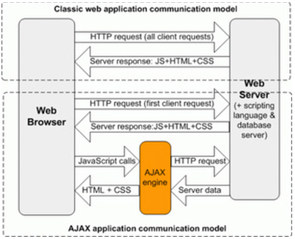
WEB ARCHITECTURE - AJAX
So far, every interaction we have had with a web server required us to make an HTTP request. Which involves either typing in a URL, clicking on a link or submitting a form.
However, if you’ve used Google mail. You know that it doesn’t need you to click a button to get it to show you new messages. You don’t need to reload the page either.
So, what’s going on here?
This Photo by Unknown Author is licensed under CC BY-SA

Slide 10
WEB ARCHITECTURE - AJAX
Remember JavaScript? The programming language that lives in your browser?
Well among its functions is one called fetch() and it does exactly what you expect. It generates an HTTP request for you!
This Photo by Unknown Author is licensed under CC BY-SA

Slide 11
AJAX - Introduction
These kinds of web architectures are known as AJAX or “Web 2.0” (if you go far enough back in time).
AJAX is an acronym stands for Asynchronous Javascript and XML
The idea here is that developers could use a JavaScript call to send very simple HTTP Requests to a server-side script which could do all the calculations or database lookups that an application needs. Then send back just the data you wanted. Relying on the client-side JavaScript to make any changes to the UI.
As per the name, originally it was thought that XML would be the format that was used to send data back and forth between the web-browser and the server-side script. However today a format known as JSON is used the most frequently.

Slide 12
AJAX - Introduction
fetch() is the JavaScript call that is the most widely used to create AJAX applications. As the acronym AJAX implies this call operates asynchronously – that is, when a request is sent the JavaScript code doesn’t wait around for the HTTP Response. The browser simply goes back to whatever it was doing and when the HTTP Response arrives it executes a function to handle it.
The point of AJAX is to make web applications more responsive and efficient. This is done by:
Avoiding the cost of reloading the entire page.
Sending the minimal amount of data to the server-side script.
Allowing the client to do other tasks while waiting for server responses (asynchronous requests)

Slide 13
AJAX - Introduction
We won’t be going too much into the details of implementing AJAX applications, but we will explore one example: async.php which is available in Canvas. All this script does is wait for a POST request containing the field name then it waits 1-3 seconds before invoking session_create_id() – a PHP command to create a long random string. It then puts this in the HTTP response using the echo command.
<?PHP
if (isset($_POST['name']) ){
sleep(rand(1,3);
$id = session_create_id();
print $id; }
else {
print "GET request. No body data sent.";
}

Slide 14
AJAX - Introduction
To get an idea how AJAX works we will call our PHP code using some JavaScript. You can find this example in the file called async.html in Canvas. Our script uses the fetch() command to send a POST request to async.php. We tell fetch that the Content-Type should be the same as an HTML form (the PHP $_POST array will only hold form data). Then we set the body to what a HTML form would pass. Namely the field “name” and it’s value “test.
<html>
<p id="data"></p>
<script>
fetch('async.php’,
{ method: 'POST',headers: {'Content-Type': 'application/x-www-form-urlencoded'},body: 'name=test’})
.then(response => response.text())
.then(result => document.getElementById('data').innerHTML = result);</script>
<body></body></html>

Slide 15
AJAX - Introduction
At this point our browser simply stops executing the JavaScript. The PHP script, if you recall is waiting 1-3 seconds before it sends its response. When it does, JavaScript calls the first .then() clause which extracts the HTTP response body and passes it to the next .then() clause which stores it in the paragraph tag with the ID “data”.
It’s not necessary to understand every aspect of this script but it’s important to understand that many web applications operate in an asynchronous manner.
<html>
<p id="data"></p>
<script>
fetch('async.php’,
{ method: 'POST',headers: {'Content-Type': 'application/x-www-form-urlencoded'},body: 'name=test’})
.then(response => response.text())
.then(result => document.getElementById('data').innerHTML = result);</script>
<body></body></html>

Slide 16
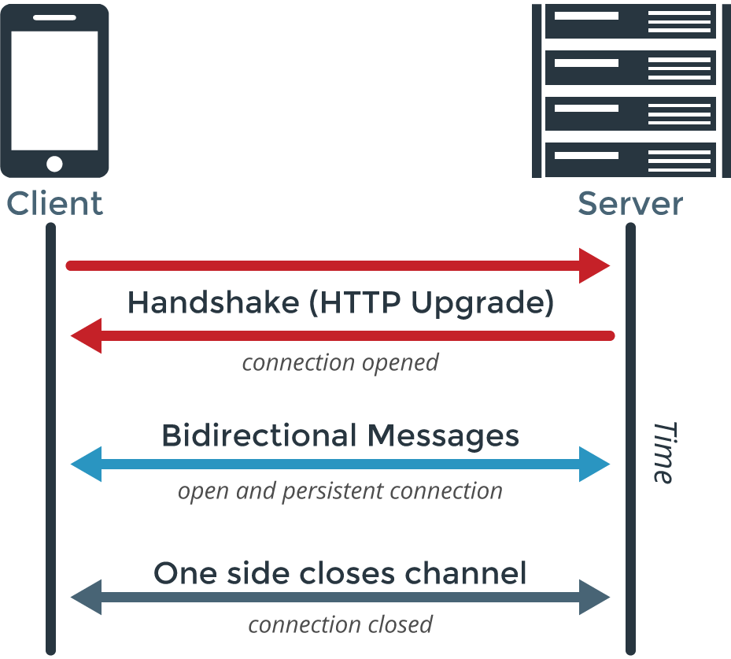
Web Sockets
So, fetch() fixes all the issues with synchronous web applications. Right? Well, not exactly.
Suppose, we wanted to make a clone of Gmail and we wanted it to seamlessly update our mailbox without reloading a page or clicking a button.
We could write some JavaScript to call fetch() every few seconds, or minutes.
However, since most people don’t get mail every minute. Most of those calls will be wasted.
This Photo by Unknown Author is licensed under CC BY-SA-NC

Slide 17
Web Sockets
Web sockets can fix this!
Web sockets are a way of enabling bi-directional communication between your web browser and a web server.
So instead of constantly checking for messages our web browser can connect to the server.
Open a web socket, then simply wait around until the server notifies us that we have a message.
This Photo by Unknown Author is licensed under CC BY-SA-NC

Slide 18
Web Sockets
We won’t be covering WebSockets in significant detail in this course. For the purposes of auditing web applications, it’s enough to know that this kind of architecture exists.

